Slide 1

Computer Architecture
Keivan Navi
Cal Poly Pomona University
knavi@cpp.edu
Office hours: Tu/Th 5:25 Pm to 6:55 Pm
Office: 8-49

Slide 2
Computer Architecture
Synchronous
Counter

Slide 3
Synchronous counter
A Synchronous counter is the counter in which the clock input with all the flip-flops uses the same source and produces the output at the same time.
Asynchronous Counter: Also known as a ripple counter, where flip-flops are triggered by the output of the preceding flip-flop. Each flip-flop changes state sequentially. Synchronous Counter: All flip-flops are triggered simultaneously by a common clock signal, ensuring that all state changes occur at the same time.

Slide 4
Synchronous counter (continued)
Synchronous counters eliminate the cumulative flip-flop delay seen in ripple counter. Each flip-flop is clocked by the same clock signal. Each gate selectively controls when each more significant bit flip-flop is to change state (toggle) on the next clock transition. Some times we use “state Diagram” to design a sequential circuit. A state diagram is used in computer science and related fields to describe the behavior of systems.
The main disadvantage of a synchronous counter is, it needs a lot of additional logic to execute. They need large components & circuitry. This counter uses a complex logic circuit & the increasing number of states.

Slide 5
Asynchronous or Synchronous
Synchronous circuits are digital circuits that are synchronized by clock signals. Asynchronous circuits are digital circuits that do not rely on clock signals.
So many wonderful asynchronous circuits can be designed. We can design and even publish a good scientific paper but sometimes when it is supposed to be mass produced, it may be hard to sell them. The noise is a serious issue.
That’s why even some researchers love asynchronous designing, they prefer synchronous approach.

Slide 6


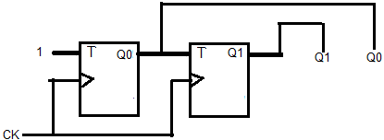
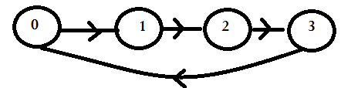
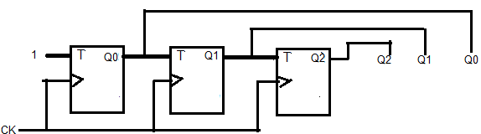
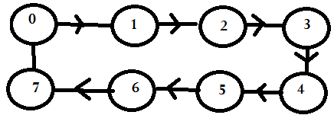
Synchronous Counters (1,2,3 bits)
1 bit synchronous Counter:
State Diagram
2 bits synchronous Counter:
3 bits synchronous Counter:

Slide 7
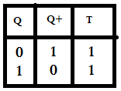
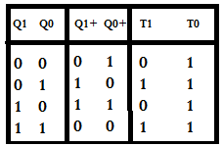
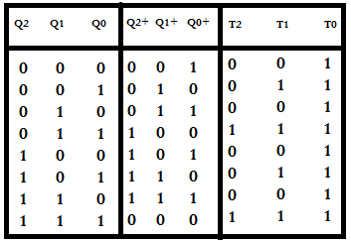
How to design with T Flip-Flop
One bit Up counter:
2 bits Up Counter:

Slide 8
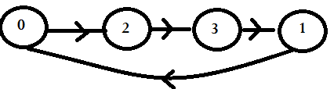
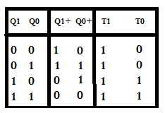
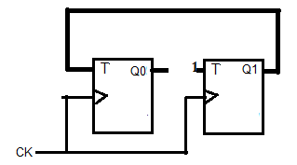
0=>2=>3=>1=>0 00=>10=>11=>01=>00
Is it OK?
State Diagram:

Slide 9
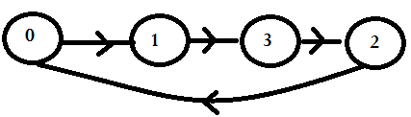
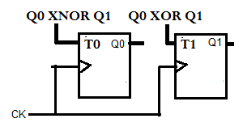
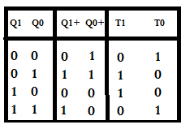
0=>1=>3=>2=>0 00=>01=>11=>10=>00
Is it OK?
State Diagram:

Slide 10
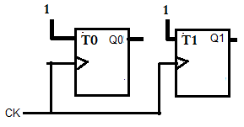
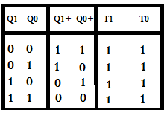
3=>2=>1=>0=>3 11=>10=>01=>00=>11
Does it work? It seems that something is going wrong. But that is not true. Why?
What is the state Diagram?

